Slide 1
Big O
Notation
Lab 20

Slide 2
Big-O Notation
Big-O notation is an assessment of an algorithm’s efficiency. Big-O notation helps gauge the amount of work that is taking place.
Actual runtime function Big-Oh notation
31, 500, etc. O(1)
3n + 1, 5n – 2, ½n, etc. O(N)
n² + 5n – 9, 4n² + 12, etc. O(N²)
5n³ – 4n² + 5n – 9, etc. O(N³)
Notes:
Constants, low-order terms, and the coefficient of the highest order term are ignored in assessing big-O run times. This is because for large values of n the highest-order term is much more significant than the others because it grows so much faster.

Slide 3
Big-O frequently used notations
Name | Notation
constant | O(1)
logarithmic | O(log₂N)
linear | O(N)
linearithmic | O(N log₂N)
quadratic | O(N²)
exponential | O(2^{n})
factorial! | O(n!)

Slide 4
Big-O frequently used notations
n | O(1) | O(log₂N) | O(N) | O(N²) | O(2^{n})
16 | 1 | 4 | 16 | 256 | 65536
128 | 1 | 7 | 128 | 16384 | 3.4E38
1024 | 1 | 10 | 1024 | 1048576 | > 1E99
1048576 | 1 | 20 | 1048576 | 1.1E12 | > 1E99
2^30 | 1 | 30 | 2^30 | 1.2E18 | > 1E99

Slide 5
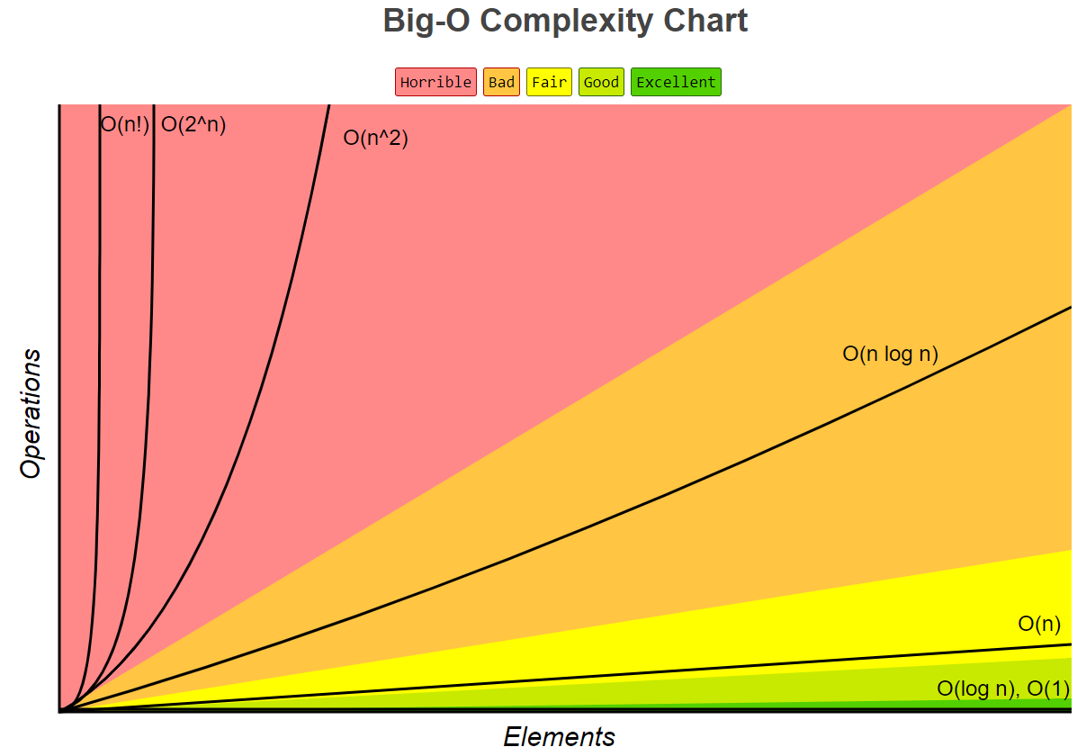

Slide 6
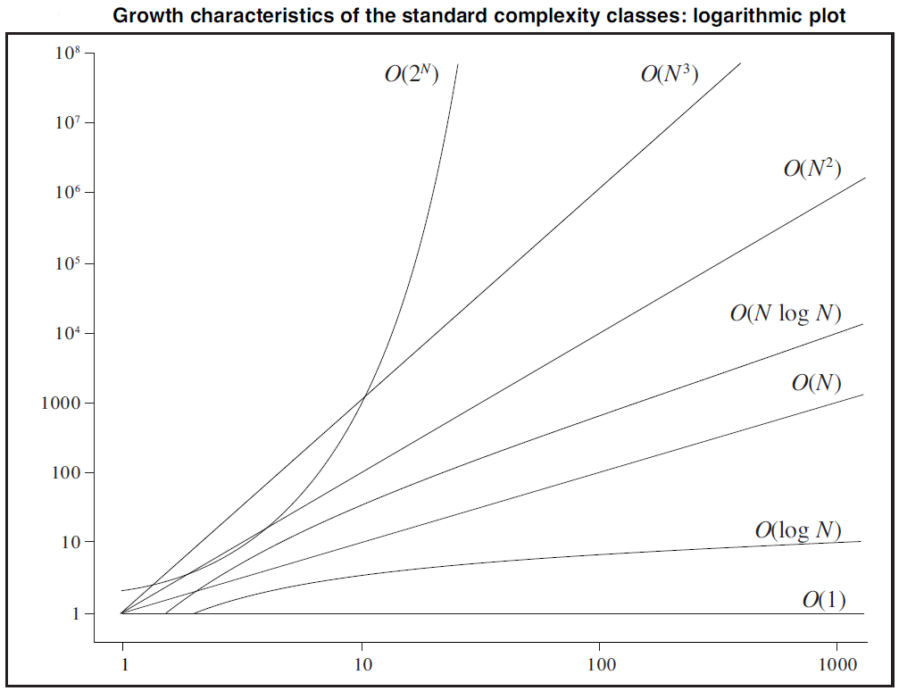

Slide 7
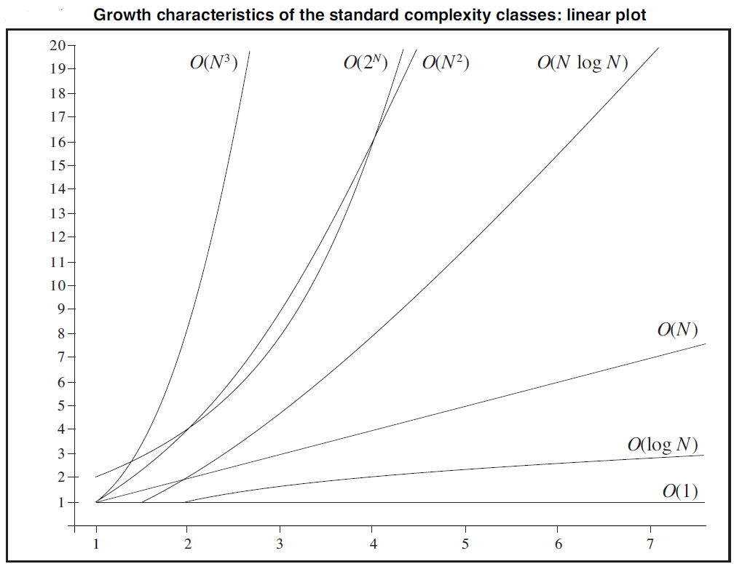

Slide 8
Examples
1. Search an unordered list of n elements.
Runtime: O(n)
2. Print the last five elements of any size array.
Runtime: O(1)
3. Binary Search.
Runtime: O(log n)
Notes:
Example 1: Search an unordered list of n elements.
Runtime: It could need n comparisons, so this search algorithm is O(n).
Example 2: Print out the last five elements of an large array.
Runtime: Same irrespective of length of list. The runtime is always 5, so the algorithm is O(1).

Slide 9
Big-O Notation
One of the main reasons for consulting
Big-O is to make decisions about which
algorithm to use for a particular job.
Notes:
If you are designing a program to sort 2 trillion data base records, writing an N² sort instead of taking the time to design and write an N*LogN sort, could cost you your job.

Slide 10
Big-O Notation
int fun = //some input
if(fun>30){
out.println("whoot");
else if(fun<=30){ out.println("fly");
}
Total work = 1
O(1) is called Constant run time and means the amount of time the code takes to run doesn’t depend on the input / data.
Notes:
In order to properly apply a BigO notation, it is important to analyze a piece of code to see what the code is doing and how many times it is doing it.
In the example above, the if else statement will only print out one time. The if will print whoot if fun is greater than 30. The if will print out fly if fun is less than or equal to 30. The code above can only do one thing each time it is executed.
Total work = 1

Slide 11
Analyzing Code
int run = //some input
for(int go=1; go<=run; go++)
{
int fun = //some input
if(fun>30){
out.println("whoot");
else if(fun<=30){ out.println("fly");
}
}
Runs run times
Each time the loop runs, the if prints.
Total work = run * 1
O(n) is called Linear run time and means the amount of time the code takes to run is directly proportional to the size of the data.
Notes:
In the example above, the for loop will execute run times. The if statement will execute each time the for loop iterates. The if else statement will only print out one time. The if will print whoot if fun is greater than 30. The if will print out fly if fun is less than or equal to 30.
Total work = run * 1

Slide 12
Big-O Notation
The BigO determined for a section of code
should be the most restrictive BigO possible
so that the BigO grows at a faster rate than
the actual runtime of the code.
For the previous example, N is the most
appropriate BigO as it meets the criteria
and is the most restrictive BigO that would
match the formal definition.

Slide 13
Linear vs Quadratic Growth
n | O(N) | multiplier | O(N²) | multiplier
5 | 5 | 1 | 25 | 1
5 x 2 | 10 | 2 | 100 | 4
5 x 10 | 50 | 10 | 2,500 | 100
5 x 100 | 500 | 100 | 250,000 | 10,000
Notes:
If the data doubles in size, a linear algorithm will take twice as long, but a quadratic algorithm will take four times as long.
If the multiplier is ten, then a quadratic algorithm will take ten squared or one hundred times as long.

Slide 14
Calculating Big O
The Big O for a sequence of commands is their sum, so it’s just Big O of the “largest” / slowest.
Notes:
In the example above, the for loop will execute run times. The if statement will execute each time the for loop iterates. The if else statement will only print out one time. The if will print whoot if fun is greater than 30. The if will print out fly if fun is less than or equal to 30.
Total work = run * 1

Slide 15
Calculating Big O
Example:
x = 5
while(x < n)
x += 1
print(x)
O(1)
⎞
⎬
⎠
O(n)
Overall Big O = O(n)
Notes:
In the example above, the for loop will execute run times. The if statement will execute each time the for loop iterates. The if else statement will only print out one time. The if will print whoot if fun is greater than 30. The if will print out fly if fun is less than or equal to 30.
Total work = run * 1

Slide 16
Calculating Big O
A loop that increments by a constant amount is O(n).
A loop that increments by successive multiplication/division is O(log n).
Multiply the Big O for a loop times the Big O for the body of the loop.
Notes:
In the example above, the for loop will execute run times. The if statement will execute each time the for loop iterates. The if else statement will only print out one time. The if will print whoot if fun is greater than 30. The if will print out fly if fun is less than or equal to 30.
Total work = run * 1

Slide 17
Now it is time for
another round of ....
What is the Big-O?

Slide 18
What is the Big-O?
for(int i=ray.size()-1; i>=0; i--)
out.println( ray.get(i) );
ray is an ArrayList!
This one is clearly N as we access all N items.
Big O Notation – O(N)

Slide 19
What is the Big-O?
for(int i=ray.size()-1; i>=0; i--)
if (ray.get(i).equals(5))
ray.remove(i);
O(log₂N)
O(N)
O(N²)
Which roof/bound fits best?
CODE for . . . N
out . . .
CODE for . . . N
out . . .
CODE for . . . N
out . . .

Slide 20
What is the Big-O?
int n = ray.size();
for(int i=0; i<n; i+=2)
out.println( ray.get(i) );
O(N)
O(N²)
Which roof/bound fits best?
O(log₂N)
CODE for . . . N
out . . .
CODE for . . . N
out . . .
CODE for . . . N
out . . .
Notes:
This code will print N/2 items, which is still O(N)

Slide 21
Big-O Notation
int n = ray.size();
for(int i=0; i<n; i+=2)
out.println( ray.get(i) );
N/2 * 1 == O(N) because it’s a linear expression.
Notes:
The fact that the coefficient is ½ doesn’t change that.

Slide 22
What is the Big-O?
int n = ray.size();
for(int i=0; i<n; i++)
for(int j=0; j<n;j++)
out.println( ray.get(i) );
ray is an ArrayList!
Big-O Notation – O(N²)
N*N units of work are needed to print each N*N element.

Slide 23
What is the Big-O?
ray is an ArrayList!
int n = ray.size();
for ( int i=0; i<n; i++)
for(int j=1; j<n; j*=2)
out.println( ray.get(i) );
Big-O Notation – O(N*Log₂N)
N * log2N units of work are needed to print each element log₂ times.

Slide 24
What is the Big-O?
ray is an ArrayList!
int n =???;
for(int i=0; i<ray.size(); i++)
out.println( ray.get(i) );
for(int j=0; j<list.size();j++)
out.println( list.get(i) );
Big-O Notation – O(N)
N + N = 2N units of work, which makes it a O(N) algorithm

Slide 25
“The Twelve Days of Christmas”
On the first day of Christmas my true love gave to me a partridge in a pear tree.
On the second day: two turtle doves and a partridge in a pear tree.
On the third day: three French hens two turtle doves and a partridge in a pear tree.
Notes:
Example 1: Search an unordered list of n elements.
Runtime: It could need n comparisons, so this search algorithm is O(n).
Example 2: Print out the last five elements of an large array.
Runtime: Same irrespective of length of list. The runtime is always 5, so the algorithm is O(1).

Slide 26
“The Twelve Days of Christmas”
On the twelfth day of Christmas my true love gave to me twelve drummers drumming eleven pipers piping ten lords a leaping nine ladies dancing eight maids a milking seven swans a swimming six geese a laying five gold rings four calling birds three french hens two turtle doves and a partridge in a pear tree.
Notes:
Example 1: Search an unordered list of n elements.
Runtime: It could need n comparisons, so this search algorithm is O(n).
Example 2: Print out the last five elements of an large array.
Runtime: Same irrespective of length of list. The runtime is always 5, so the algorithm is O(1).

Slide 27
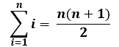
“The Twelve Days of Christmas”
for (int x=1; x<=12; ++x)
for(int y=x; y>=1; --y)
out.println( verse(y) );
Notes:
Example 1: Search an unordered list of n elements.
Runtime: It could need n comparisons, so this search algorithm is O(n).
Example 2: Print out the last five elements of an large array.
Runtime: Same irrespective of length of list. The runtime is always 5, so the algorithm is O(1).

Slide 28
What is the Big-O?
for (int x=1; x<=12; ++x)
for(int y=x; y>=1; --y)
out.println( verse(y) );
Big-O Notation – O(N²)
The inner loop runs some fraction of N times, which makes it an O(N) loop.

Slide 29
What is the Big-O?
ray is an ArrayList!
int n = ray.size();
for ( int i=0; i<n; i++)
for(int j=0; j<i; j++)
out.println( ray.get(i) );
Big-O Notation – O(N²)
The inner loop runs some fraction of N times, which makes it an O(N) loop.

Slide 30
Comparing Runtimes
of Arrays & Lists

Slide 31
Arrays
traverse all spots O(N)
search for an item O(N) or O(Log₂N)
remove any item O(N) location unknown
get any item O(1) location known
add item at the end O(1)
add item at the front O(N)
If sorted, use binary search
An array is a collection of like variables.
1 | 5 | 8 | 9 | 11

Slide 32
Java Collections – ArrayList
traverse all spots O(N)
search for an item O(N) or O(Log₂N)
remove any item O(N) location unknown
get any item O(1) location known
add item at the end O(1)
add item at the front O(N)
ArrayList is implemented with an array.
If sorted, use binary search

Slide 33
Single Linked Lists
traverse all nodes O(N)
search for an item O(N)
remove any item O(N) location unknown
get any item O(N) location unknown
add item at the end O(1) (if tail is stored)
O(N) (if no link to tail)
add item at the front O(1)
A single linked node has a reference to the next node only.
A single linked node has no reference to the previous node.
10

Slide 34
Double Linked Lists
traverse all nodes O(N)
search for an item O(N)
remove any item O(N) location unknown
get any item O(N) location unknown
add item at the end O(1)
add item at the front O(1)
A double linked node has a reference to the next node and to the previous node.
10

Slide 35
Java Collections – LinkedList
traverse all spots O(N)
search for an item O(N)
remove any item O(N) location unknown
get any item O(N) location unknown
add item at the end O(1)
add item at the front O(1)
LinkedList is implemented with a double linked list.

Slide 36
General Big O Chart
for Searches
Name Best Cast Avg. Case Worst
Linear/Sequential Search O(1) O(N) O(N)
Best: The item searched for is in the first spot searched.
Average: Assuming the value searched for is in the list and each list element is equally likely to be the value searched for, the search visits only n/2 elements.
Worst case: The search must visit every element once. This happens when the value being searched for is either the last element in the list, or is not in the list.

Slide 37
General Big O Chart
for Searches
Name Best Cast Avg. Case Worst
Binary Search O(1) O( log₂ N ) O( log₂ N )
Best: The item searched for is in the first spot searched.
Average: Every step eliminates half the list, so the run-time is proportion to log₂ n.
Worst: Searching for an item which is not in the data. In this case, each time the algorithm did not find the target, it would eliminate half the list to search through, so O(log n).

Slide 38
General Big O Chart
for Searches
Name Best Cast Avg. Case Worst
Linear/Sequential Search O(1) O(N) O(N)
Binary Search O(1) O( log₂ N ) O( log₂ N )
All searches have a best case run time of O(1) if written properly.
You have to look at the code to determine if the search has the
ability to find the item and return immediately. If this case is present,
the algorithm can have a best case of O(1).

Slide 39
General Big O Chart
for N^2 Sorts
Best Case Avg. Case Worst
Selection Sort O(N²) O(N²) O(N²)
In each case ≈ n comparisons and 1 swap in each of n - 1 passes.

Slide 40
General Big O Chart
for N^2 Sorts
Best Case Avg. Case Worst
Bubble Sort O(N²) O(N²) O(N²)
Bubble sort always continues swapping items even after everything is sorted.

Slide 41
General Big O Chart
for N^2 Sorts
Best Case Avg. Case Worst
Insertion Sort O(N) O(N²) O(N²)
Best: already sorted. 1 comparison and no data moves in each of n – 1 passes.
Worst: sorted in reverse order. Needs ≈ n comparisons and n data moves in each pass.

Slide 42
General Big O Chart
for N^2 Sorts
Name Best Case Avg. Case Worst
Selection Sort O(N²) O(N²) O(N²)
Bubble Sort O(N²) O(N²) O(N²)
Insertion Sort O(N) O(N²) O(N²)

Slide 43
General Big O Chart
for NLogN Sorts
Best Case Avg. Case Worst
Merge Sort O(n log n ) O(n log n ) O(n log n )
log₂ n splits gives n arrays of 1 element.
n elements examined to merge on each level.

Slide 44
O(1) — constant
• finding a median value in a sorted array
• push, pop, peek, & isEmpty methods in Stack
• add, remove, peek, & isEmpty methods in PriorityQueue
• finding a key in a lookup table
• finding a key in an efficient, sparsely populated hash table
• retrieving a target value in an efficient, sparsely populated hash table
• adding an element to the end of an ArrayList
• addFirst, addLast, getFirst, getLast, removeFirst, & removeLast methods in LinkedList
• put, get, containsKey, & size methods in HashMap
• add, remove, contains, & size methods in HashSet

Slide 45
O(log n) — logarithmic
• Binary Search (array must be sorted)
• searching a balanced binary search tree (worst case is O(n) if BST is unbalanced)
• inserting a node into a binary search tree
• add and remove methods in PriorityQueue (implemented as a heap)
• containsKey, get, & put methods in TreeMap
• contains, add, & remove methods in TreeSet

Slide 46
O(n) — linear
• traversing a List (e.g. finding max or min)
• sequential search through an array or ArrayList
• calculating the sum of n elements in an array, ArrayList, List, or Set
• calculating n-factorial with a loop
• calculating Fibonacci numbers with a loop
• Recursive Fibonacci (implemented using memoization)
• traversing a tree with n nodes

Slide 47
O(n log n) — “n log n” time
• Mergesort
• Quicksort
• Heapsort
• creating a binary search tree if nodes inputted in random order leading to a balanced BST (worst case is O(n2))

Slide 48
O(n²) — quadratic
• Selection Sort
• Insertion Sort
• Bubble Sort
• traversing a two-dimensional array
• finding duplicates in an unsorted list of n elements (using nested loops)

Slide 49
O(a^{n}) (where a > 1) — exponential time
• Recursive Fibonacci (naïve implementation)
• Towers of Hanoi
• Generating all permutations of n letters

Slide 50
Big-O Notation
The formal definition for BigO is :
BigO is bound(N) if runTime(N) <= c * bound(N)
The actual runtime of an algorithm is the
upper bound if the actual runtime is less than
c times an upper bound with c being a non-negative
constant and using any value of N greater than n₀.
Say what?
Notes:
First, we calculate the actual runtime (how much actual work is going on) for the code we are analyzing. The most common way to determine the actual runtime is by looking at the code and determining how many times the code prints, adds, iterates, or does any type of real work.
After the actual run time is known, an upper bound needs to be determined. Many times the upper bound is very obvious and other times it is less obvious.
The formula above allows the actual runtime to be compared to the upper bound to determine if it is appropriate. When proofing an upper bound, c and n₀ are constant values. n₀ gives a point from which to pick N as N must be larger than n₀ c is used as a multiplier for bound(N).

Slide 51
Big-O Notation
int run = //some input
for(int go=1; go<=run; go=go+2)
{
int fun = //some input
if(fun>30){
out.println("whoot");
else if(fun<=30){ out.println("fly");
}
}
runTime(N) – n/2 * 1
bound(N) – ????
runTime(N) <= c * bound(N)
n/2*1 <= ??
Notes:
First, we calculate the actual runtime for the code above. The loop runs n/2 times. Each time the loop iterates it prints either whoot or fly. The loop iterates n/2 times which equals n/2 units of work. For each of the n/2 iterations, the loop performs one print which is equal to 1 unit of work.
Actual run time = n/2*1
Now that the actual run time is known, an upper bound needs to be chosen so that the formula can be tested.

Slide 52
Big-O Notation
runTime(N) <= c * bound(N)
int run = 50
for(int go=1; go<=run; go=go+2)
{
int fun = //some input
if(fun>30){
out.println("whoot");
else if(fun<=30){ out.println("fly");
}
}
n/2*1 <= c * log₂n
n₀ = 2
c = 3
50/2*1 <= 3*6
25 <= 18
O(log₂n) is too small.
Notes:
Actual run time = n/2*1
Now that the actual run time is known, lets proof the formula by picking an upper bound of log₂n.
For the formula, we need a value for c, n₀, and a value for N.
If c is 3 and n₀ is 2, we can pick 8 for N and the formula would be
8/2*1 <= 3*3 4<=9
This looks pretty good so far.
If c is 3 and n₀ is 2, we can pick 45 for N and the formula would be
45/2*1 <= 3*6 22<=18
This does not look so good.

Slide 53
Big-O Notation
runTime(N) <= c * bound(N)
int run = 50
for(int go=1; go<=run; go=go+2)
{
int fun = //some input
if(fun>30){
out.println("whoot");
else if(fun<=30){ out.println("fly");
}
}
n/2*1 <= c * n
n₀ = 2
c = 3
50/2*1 <= 3*50
25 <= 150
O(n) is just right.
Notes:
Actual run time = n/2*1
Now that the actual run time is known, lets proof the formula by picking and upper bound of n.
For the formula, we need a value for c, n₀, and a value for N².
If c is 3 and n₀ is 2, we can pick 8 for N and the formula would be
8/2*1 <= 3*8 4<=24
This looks pretty good so far.
If c is 3 and n₀ is 2, we can pick 45 for N and the formula would be
45/2*1 <= 3*45 22<=135
This still looks pretty good.

Slide 54
Big-O Notation
runTime(N) <= c * bound(N)
int run = 50
for(int go=1; go<=run; go=go+2)
{
int fun = //some input
if(fun>30){
out.println("whoot");
else if(fun<=30){ out.println("fly");
}
}
n/2*1 <= c * n²
n₀ = 2
c = 3
50/2*1 <= 3*2500
25 <= 7500
O(n²) is too big.
Notes:
Actual run time = n/2*1
Now that the actual run time is known, lets proof the formula by picking and upper bound of n.
For the formula, we need a value for c, n₀, and a value for N.
If c is 3 and n₀ is 2, we can pick 8 for N and the formula would be
8/2*1 <= 3*8*8 4<=192
This looks okay as the 4 is less than 192, but seems a bit excessive.
If c is 3 and n₀ is 2, we can pick 45 for N and the formula would be
45/2*1 <= 3*45*45 22<=6075
This looks okay as the 22 is less than 6075, but seems way beyond what is needed.
N² will not work as it is not the most restrictive bound that could be used.

